Slide 1



Recommender Systems
罗平 luop@ict.ac.cn
Autumn 2016

Slide 2

Cell: 18601192631
Building a Wechat group for this class

Slide 3
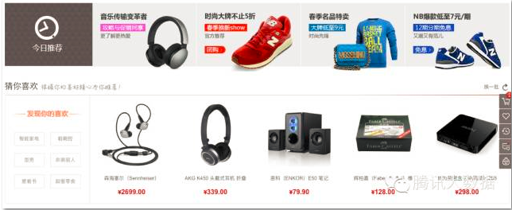
RS Everywhere
Notes:
1960s

Slide 4
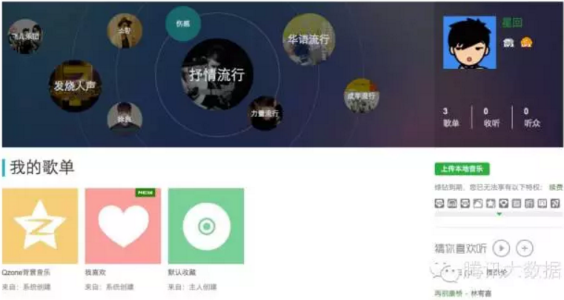
RS Everywhere
Notes:
1960s

Slide 5
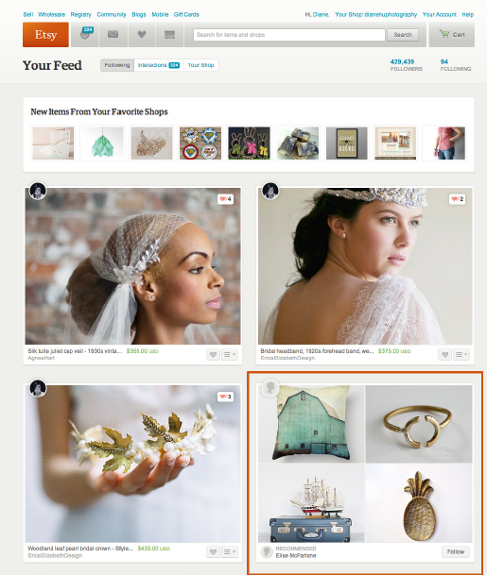
RS Everywhere
Notes:
1960s

Slide 6
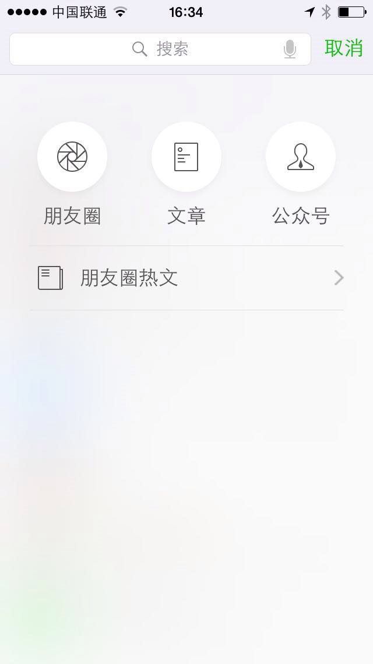
RS Everywhere
Notes:
1960s

Slide 7
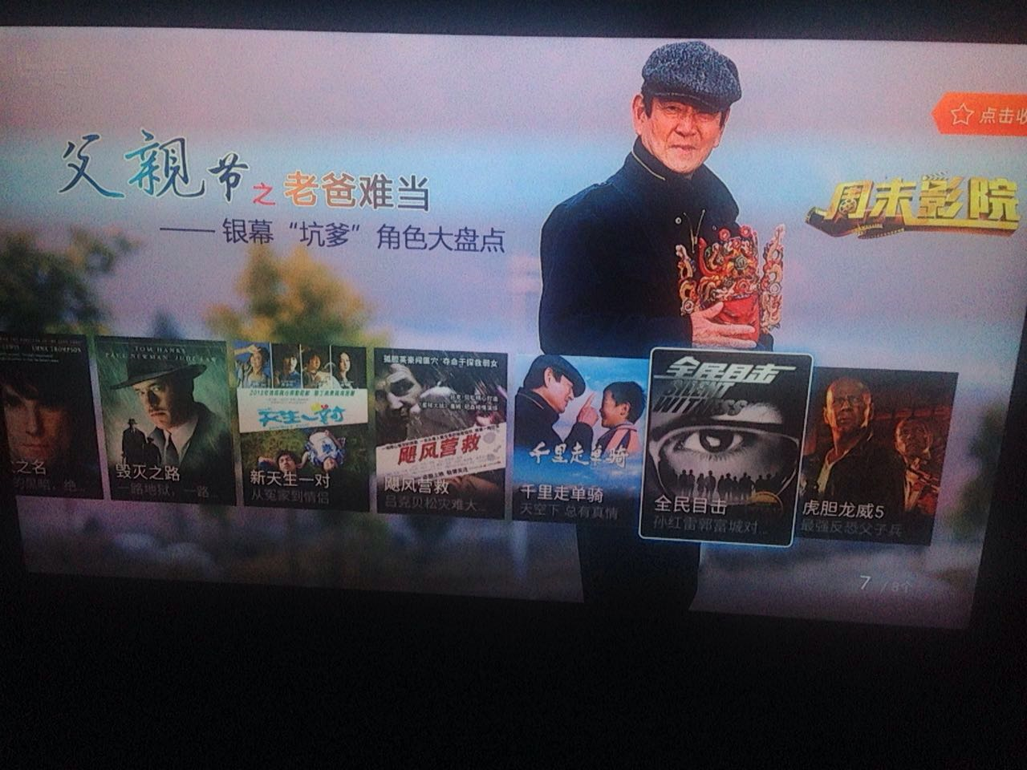
Video Recommendation at the Father’s Day
http://www.1905.com/special/dianbo/fathersday/3022-featurefilm1.html?page=1
Notes:
1960s

Slide 8
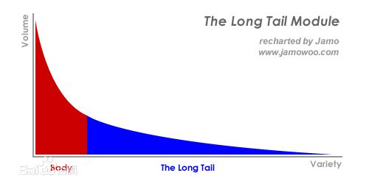
Why We Need RS
Increase dwell time
Increase conversion ration
Increase revenue
Notes:
1960s

Slide 9
Why We Need RS
Premise of Recommender Systems
Information needs more complex than keywords or topics
Quality and taste matters
Examples of Different Tastes
Tennis fans
Gift to girlfriends
Answers to your wife
Furniture
Notes:
举例：高质量的某方面的文档
it is easy to figure out the topic of an article, it is not easy to figure out if it matches your taste
example: 网球的例子
谈恋爱的例子：女友喜欢什么，老婆问你对某某问题的观点

Slide 10
Course Scope
Broad Overview of Recommendation Techniques
Algorithms
Non-personalized, content-based
Emphasis on personalized
Their drawbacks
Added topics/enrichment around interaction and design or recommender systems
Goal is to provide solid algorithmic core with extensive awareness of related topics
Enhance your experiences in research

Slide 11
Course Objective
Benefits to
Program developers for RS
Research people in RS
Product managers in RS

Slide 12
Course Time
5 nights
2 nights for the first two weeks
1 night for the last week

Slide 13
Grading
Show for the assignments (30%)
Group Reports (40%)
4 persons for one group
Any topics about RS (DEEP ANALYSIS)
One-hour final examination (40%)
No reference books permitted

Slide 14
Office Hour
4pm – 5:30pm Monday
4pm – 5:30pm Thursday
Submit your questions in the Wechat group
I will build a new Wechat group
Use your real name in the group
Or email me: luop@ict.ac.cn

Slide 15
Introduction to recommender systems
1-1

Slide 16
Learning Objectives
Understand what a recommender system is
History and background

Slide 17
History of RS
Information Retrieval and Information Filtering
Manual Collaborative Filtering
Automated Collaborative Filtering
Notes:
1960s

Slide 18
Information Retrieval
Static Content Base
Invest Time in indexing content
Dynamic Information Need
Queries submitted in real time
Common Approach: TFIDF
Rank documents by term overlap
Rank terms by frequency
Notes:
lots of books, including titles, authors, content, comments
query examples
content is relatively static
information need changes from time to time
similar to Search Engine, indexing the whole Web
TF IDF
term在一个文档里出现的次数，在其余的文档里出现的次数
举例：
recommender systems
computers

Slide 19
Information Filtering
Reverse Assumption from IR
Static information need
Dynamic content base
Invest effort in modeling user need
Hand-created profile: newspaper clipping service
Machine-learned profile
Feedback/Updates
Notes:
the information need, taste, and preference is relatively static
to find the items you may be interested in
or to find the items you don't like, spam detector

Slide 20
History of RS
Information Retrieval and Information Filtering
Manual Collaborative Filtering
Automated Collaborative Filtering

Slide 21
Manual Collaborative Filtering
Early Work for Manual Collaborative Filtering
Tapestry (挂毯)– database of content & comments (1992)
David Goldberg, David Nichols, Brian M. Oki, and Douglas Terry. 1992. Using collaborative filtering to weave an information tapestry. Commun. ACM 35, 12 (December 1992), 61-70.
Douglas B. Terry. 1993. A tour through Tapestry. In Proceedings of the conference on Organizational computing systems (COCS '93), Simon Kaplan (Ed.). ACM, New York, NY, USA, 21-30.
Notes:
举例：高质量的某方面的文档
it is easy to figure out the topic of an article, it is not easy to figure out if it matches your taste
example: 网球的例子
谈恋爱的例子：女友喜欢什么，老婆问你对某某问题的观点

Slide 22

Doug Terry
Doug Terry is a Distinguished Research Engineer at Samsung Research America.
Previously he was Principal Researcher in the Microsoft Research Silicon Valley Lab. His research focuses on the design and implementation of distributed systems with an emphasis on cloud data services, replication, ubiquitous computing, and mobility. Prior to joining Microsoft, Doug was the co-founder and CTO of a start-up company named Cogenia, Chief Scientist of the Computer Science Laboratory at Xerox PARC, and an Adjunct Professor in the Computer Science Division at U. C. Berkeley, where he regularly teaches a graduate course on distributed systems. He produced the ACM TechPack on Cloud Computing and is the Past Chair of ACM’s Special Interest Group on Operating Systems (SIGOPS). Doug has a Ph.D. in Computer Science from U. C. Berkeley, a B.A. from U. C. San Diego, and is an ACM Fellow.

Slide 23
Information Tapestry
The term collaborative filtering itself was coined by Doug Terry at Xerox PARC
Tapestry was the first system to support collaborative filtering in that it allows its users to annotate the documents they read. Other Tapestry users can then retrieve documents to read based not only on the content of the documents themselves, but also on what other users have said about them.
www.cs.cmu.edu/~dmaltz/main-report/node10.html

Slide 24
Manual Collaborative Filtering
Early Work for Manual Collaborative Filtering
Active CF – easy mechanisms for forwarding content to relevant readers (1995)
David Maltz, Kate Ehrlich: Pointing the Way: Active Collaborative Filtering. CHI 1995: 202-209
Notes:
David Maltz, Kate Ehrlich: Pointing the Way: Active Collaborative Filtering. CHI 1995: 202-209
people served as information hubs
say, you should pay attention to this because you travel a lot.
joke mailing list: manual CF, use the personal opinions to forward something you would like

Slide 25
History of RS
Information Retrieval and Information Filtering
Manual Collaborative Filtering
Automated Collaborative Filtering

Slide 26
Automated Collaborative Filtering
The GroupLens Project
Paul Resnick, Neophytos Iacovou, Mitesh Suchak, Peter Bergstrom, and John Riedl. 1994. GroupLens: an open architecture for collaborative filtering of netnews. In Proceedings of the 1994 ACM conference on Computer supported cooperative work (CSCW '94). (Google Scholar Citation: 4849)

Slide 27
Automated Collaborative Filtering
The GroupLens Project
ACF for Usenet News
Users rate items
Users are correlated with other users
Personal predictions for unrated items
Nearest-Neighbor Approach
Find people with history of agreement
Assume stable tastes

Slide 28
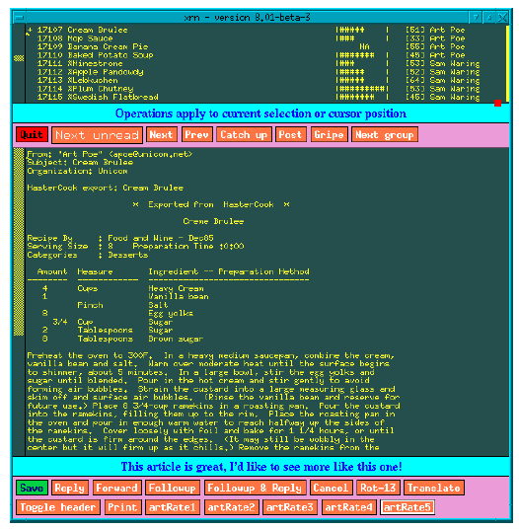
GroupLens Project

Slide 29
GroupLens, Works Meaningfully Well
Relationship with User Behavior
Twice as likely to read 4/5 than 1/2/3
Users Like GroupLens
Some users stayed 12 months after the trial!

Slide 30
ACM Software System Award (2010)
For the GroupLens Collaborative Filtering Recommender Systems, which showed how to automate the process by which a distributed set of users could receive personalized recommendations by sharing ratings, leading to both commercial products and extensive research.
http://awards.acm.org/award_winners/riedl_2663490.cfm

Slide 31
ACM Software System Award (2010)
Recommender systems have become ubiquitous. Whether shopping at Amazon.com, selecting videos at Netflix, or getting news and information, we have become accustomed to sophisticated personalization software that uses our preference data, together with the preference data of others, to provide personalized recommendations for content or products. Automated collaborative filtering, which launched the field of recommender systems in 1994, was introduced, refined, and commercialized by the team of John Riedl, Paul Resnick, Joseph A. Konstan, Neophytos Iacovou, Peter Bergstrom, Mitesh Suchak, Brad Miller, David Maltz, Jon Herlocker, Lee Gordon, Sean McNee, and Shyong (Tony) K. Lam through the GroupLens family of systems.

Slide 32
ACM Software System Award (2010)
The first generation GroupLens system (1994) was used to create personalized recommendations of Usenet news articles. The second generation (1995-1996) also targeted Usenet news articles, and led to the commercial launch of Net Perceptions, spawning what is now a vibrant recommender systems industry. After commercialization, the team launched MovieLens in 1997. MovieLens, a web-based research platform still operating today, has been used by more than 100,000 users; its online experiments and published datasets have led to hundreds of published advances in the field of recommender systems.

Slide 33
Prior to GroupLens, most personalization systems were based entirely on building profiles of content preferences, and then applying them to new content. While this technique worked when interests were topical (e.g., choosing news about a favorite football club), they did not handle less feature-based preferences or distinguish among topical items by quality or taste. In 1992, Xerox PARC's Tapestry project introduced the term and concept "collaborative filtering", creating a centralized database where annotations could be stored and retrieved, but application of this idea was limited by the need to manually form queries and explore the database. The GroupLens team introduced automation to the process, which proved to be the fundamental breakthrough that enabled wide-ranging research and commercial applications.

Slide 34
Through the founding of Net Perceptions, GroupLens had an enormous impact on e-commerce and information portals. Early customers, including Amazon.com, CDnow, and Art.com, demonstrated that the software generalized to a wide variety of domains, and validated the usefulness of collaborative filtering recommendation through explicit and implicit user ratings . Net Perceptions grew to become a $1 billion company, providing recommender systems to leading retail and information companies around the world. Recommender systems grew into an extensive research field, drawing from machine learning, human computer interaction, ecommerce, information retrieval, databases, and other areas of computer science. ACM's annual Recommender Systems Conference brings together leading researchers and practitioners. The field was recently energized by the $1 million Netflix Challenge.

Slide 35
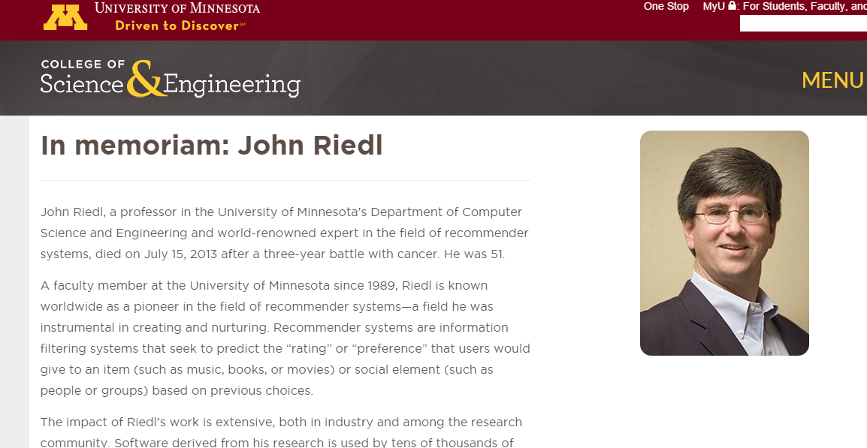
In Memory of John Riedl

Slide 36
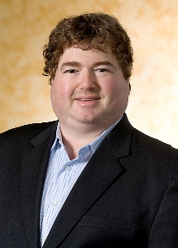

Acknowledgement
Coursera course
Recommender Systems, an Introduction
https://www.coursera.org/learn/recommender-systems/
Instructor
Joseph A Konstan (Distinguished McKnight University Professor at the University of Minnesota)
Michael D Ekstrand (Assistant Professor at Texas State University)

Slide 37
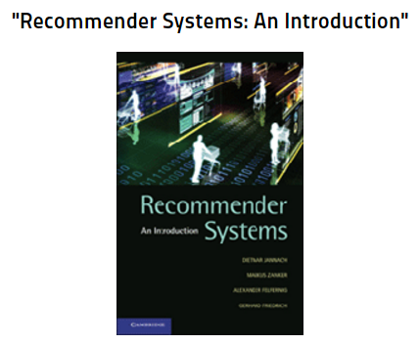
Acknowledgement

Slide 38
Analysis Framework of recommender systems
1-2

Slide 39
Learning Objectives
To understand the different types of recommender systems
A framework for analyzing recommender systems in general
A specific overview of different recommendation algorithms
To acquire a roadmap for the rest of the course, based on the algorithms studied

Slide 40
Analysis Framework
Dimension of analysis
Domain
Purpose
Recommendation context
Whose opinion
Personalization level
Privacy and trustworthiness
Interface
Recommendation algorithms

Slide 41
1 Domains of Recommendation
Content to commerce and beyond
News, information, “text”
Products, vendors, bundles (e.g., China Mobile)
Matchmaking (other people) (世纪佳缘)
Sequences (e.g. travel route)

Slide 42
2 Purposes of Recommendation
The recommendations themselves
Sales
Information
Education of user/customer
Sequences (e.g. travel route)
Build a community of users/customers around products or content

Slide 43
3 Recommendation Context
What is the User doing at the time of recommendation?
Shopping
Listening to Music
Hanging out with other people
Select the right time for recommendation
Online shopping vs. Offline shopping
How does the context constrain the recommender?
Level of attention and interruption
Good research point

Slide 44
4 Whose Opinion
Expert
Ordinary folks
People like you

Slide 45
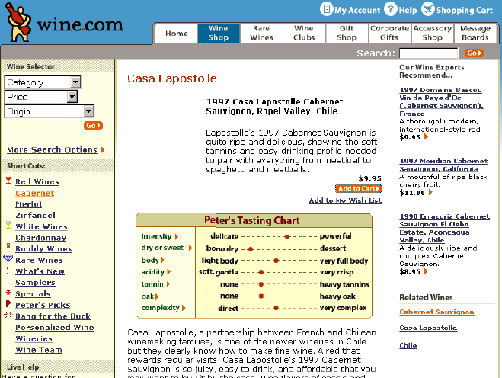
Recommendation from Experts

Slide 46
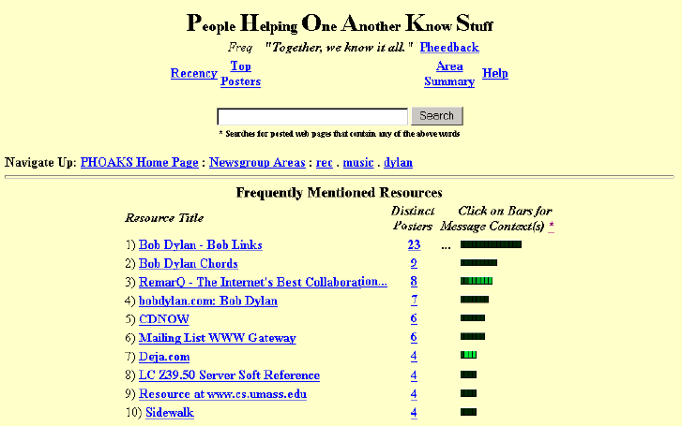
Recommendation from Ordinary Folks

Slide 47
5 Personalization Level
Generic / Non-Personalized
The same recommendation
Demographic
Match the target user group
Personalization
Ephemeral (只在短期内有用的事物)
Matches current activity
Persistent
Matches long-term interests

Slide 48
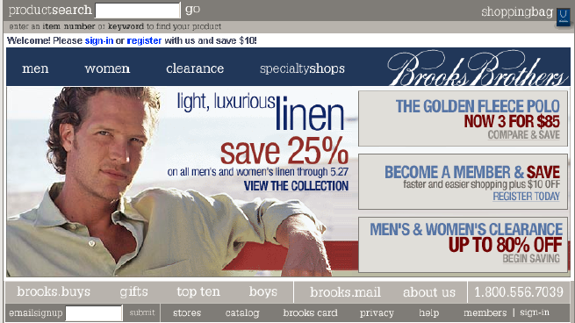
Recommendation by Demographic
Brooks Brothers

Slide 49
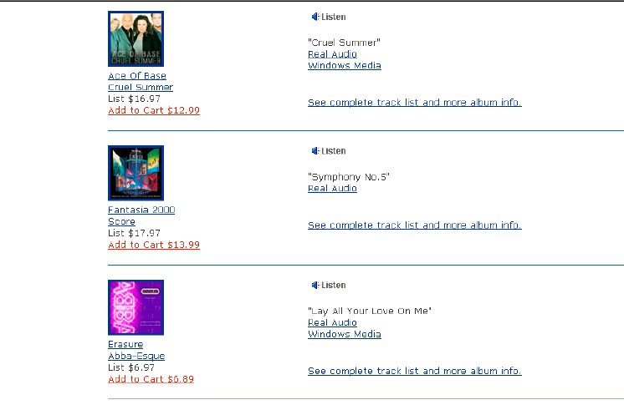
Personal Recommendation
CDNow

Slide 50
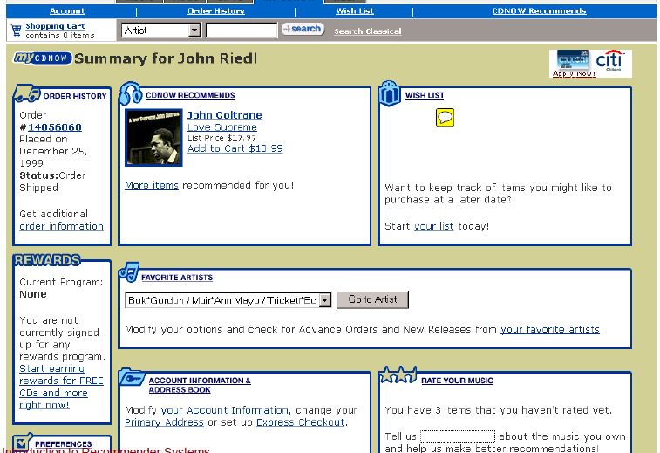
Personal Recommendation
CDNow (Wishlist for long-term interests)

Slide 51
6 Privacy and Trustworthiness
Who knows what about me?
Personal information revealed
Deniability of preferences
Is the recommendation honest
Biases built-in by operator (business rules)
Vulnerability to external manipulation
Movie box office

Slide 52
7 Interface
Type of Output
Predictions
Recommendations
Filtering
Organic or explicit presentation
Agent dialog interface
Type of input
Explicit
Implicit

Slide 53
8 Recommendation Algorithms
Non-Personalized Summary Statistics
Content-based Filtering
Information filtering
Collaborative Filtering
User-user
Item-item
Dimensionality reduction
Others
Interview based recommendation
Hybrid

Slide 54
Components in Recommendation Systems
Users
Items
Ratings (explicit or implicit)
Community

Slide 55
A Tour of Popular Websites
1-3

Slide 56
Learning Objectives
To explore a wide range of recommender systems in the context of a large, professional site
To understand how to review a recommender-enabled site
Make a reasonable guess on how to implement the RS under consideration

Slide 57
A Tour of Amazon.com

Slide 58
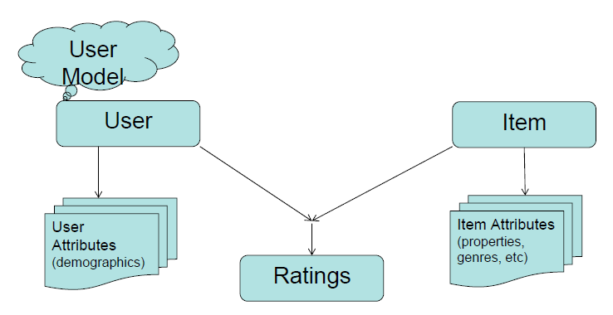
Components in Recommendation Systems

Slide 59
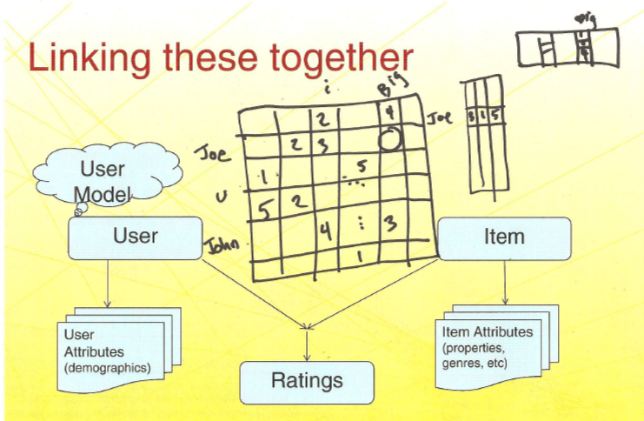
Collaborative Filtering Techniques

Slide 60
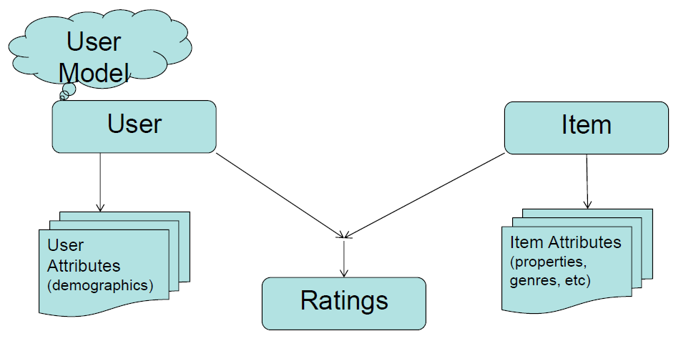
Amazon RS
Buying/ rating/ liking/
wishlist/ browsing/ basket
Heavily
categorized
Geography
Explicit: rating
Implicit: purchase, browsing

Slide 61
A Tour of iqiyi.com

Slide 62
iQiyi Features
Continuing watching across devices
Seamless rating
Video out at iQiyi
Combing shopping and video seamlessly
Shake to hide the advs

Slide 63
A Tour of JD

Slide 64
JD
As a product manager
Where to put recommendation
How to implement: the scale of users and products

Slide 65
Assignment
Analyzing a popular web site (e.g., JD, TMALL) with RS
随机点名号码(1-122): 5位同学
下次课，5位同学中的2位上台表演

Slide 66
Preferences and ratings
1-4

Slide 67
Learning Objectives
Understand types of data collected by RS
Understand when different data types are possible and appropriate
Design your product as a product manager

Slide 68
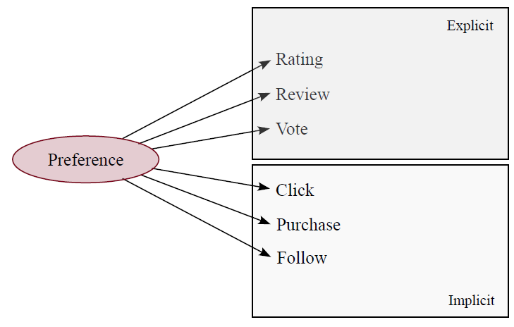
Preferences and Ratings
What users like
and dislike
Other actions
of users

Slide 69
Explicit Ratings – Star Ratings
1, 2, 3, 4, 5
Half star
Provide meanings

Slide 70
Explicit Ratings - Thumbs and Likes
Vote up/down
Net up-votes
Just “like”/ “+1”
Common with ephemeral items
News aggregation (Reddit, Digg)
Q&A (StackOverflow)
Very low cost to rate

Slide 71
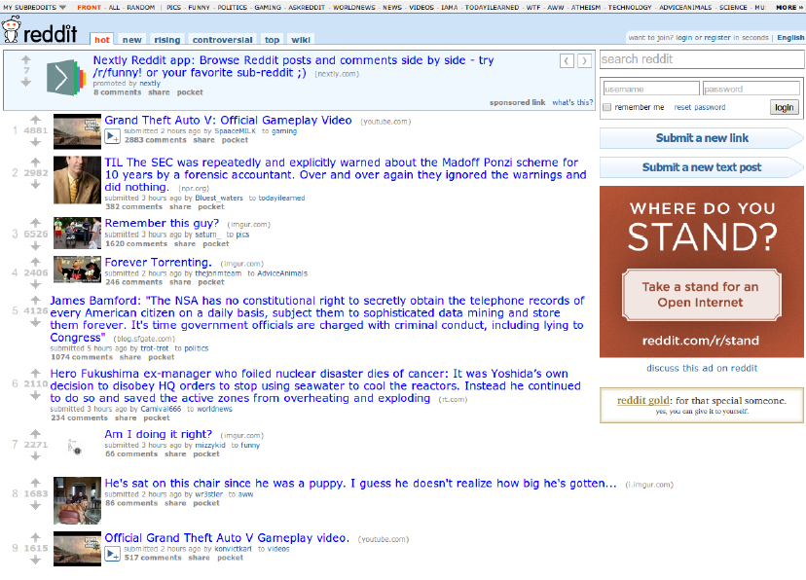

Slide 72
Explicit Ratings - Others
Continuous scale
Pairwise preferences
Percentage of “very good”
Temporary (e.g. Pandora 30-day suspend)

Slide 73
When Explicit Ratings Provided
Immediately after Consumption
Some time after consumption
By expectation
The items has not been experiences
High-price items: house, car

Slide 74
Difficulties with Explicit Ratings
Are ratings reliable and accurate?
Noise in this psychological process of voting (decision making)
User preferences change
Different meanings for the ratings
Hard to combine the multiple aspects into a single score
Different personality

Slide 75
Implicit Data
Data collected from user actions
Key difference: user action is for some other purpose, not expressing preference
Based on preferences, but not preferences
Their actions say a lot!

Slide 76
Implicit Data - Reading Time
Dwell time on items
Articles
Music
Videos
Coats and bags
Notes:
Silence is also evidence: interpreting dwell time for recommendation from psychological perspective. Peifeng Yin, Ping Luo, Wang-Chien Lee, Min Wang, KDD, 2013.

Slide 77
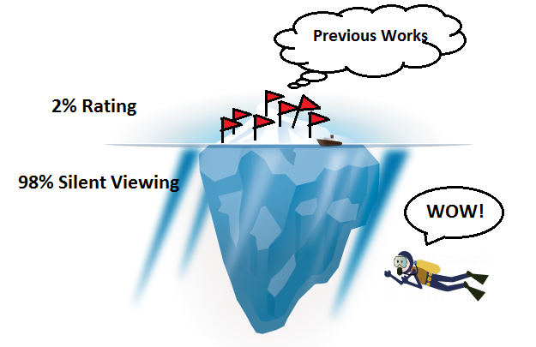
Silence is also evidence
Vote/rate is less frequent than item viewing
Silence is also evidence: interpreting dwell time for recommendation from psychological perspective. Peifeng Yin, Ping Luo, Wang-Chien Lee, Min Wang, KDD, 2013.
Notes:
Silence is also evidence: interpreting dwell time for recommendation from psychological perspective. Peifeng Yin, Ping Luo, Wang-Chien Lee, Min Wang, KDD, 2013.

Slide 78
From Silent Viewing to Pseudo Votes
Explicit Votes
Pseudo Votes
Silence is also evidence: interpreting dwell time for recommendation from psychological perspective. Peifeng Yin, Ping Luo, Wang-Chien Lee, Min Wang, KDD, 2013.
Notes:
Silence is also evidence: interpreting dwell time for recommendation from psychological perspective. Peifeng Yin, Ping Luo, Wang-Chien Lee, Min Wang, KDD, 2013.

Slide 79
Binary Actions
Click/or not
Save/or not
Purchase/or not
Follow/or not
… …

Slide 80
Subtleties and Difficulties
What does the action mean?
Purchase: they might still hate it
Don't click: expect bad, or didn't see
How to scale/represent actions
Combine multiple types of actions

Slide 81
Short Summary
Ratings provide explicit expressions of preference
Implicit data benefits from greater volume

Slide 82
Summary of This part
1-5

Slide 83
History of RS
Information Retrieval and Information Filtering
Manual Collaborative Filtering
Information Tapestry
Active CF
Automated Collaborative Filtering
Notes:
come from information reuse and persistent preferences
ant to find food
social navigation: in a building
cavemen, to judge whether the red and bright food is good or not

Slide 84
Analytic Framework for RS
Dimension of analysis
Domain
Purpose
Recommendation context
Whose opinion
Personalization level
Privacy and trustworthiness
Interface
Recommendation algorithms

Slide 85
A Tour for Amazon and JD

Slide 86
Preferences and Ratings
What users like
and dislike
Other actions
of users

